Slide 1
Serial Communication
Omid Fatemi

Slide 2
Outline
Serial vs. Parallel
RS-232
DTE, DCE
Flow control
Programming serial port
UART – 16550
UART in PC

Slide 3
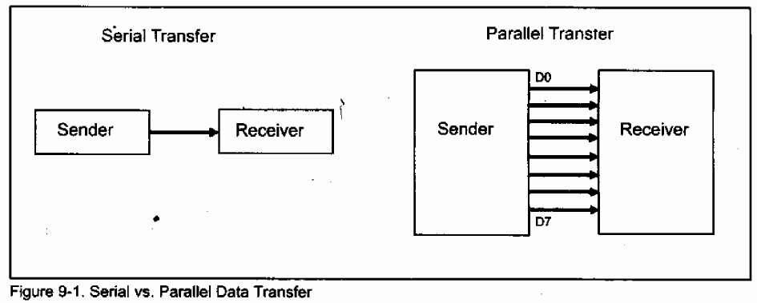
What is Serial Communications

Slide 4
Serial Communication Types
Asynchronous
Synchronous
Transfer:
Simplex
Half duplex
Full duplex

Slide 5
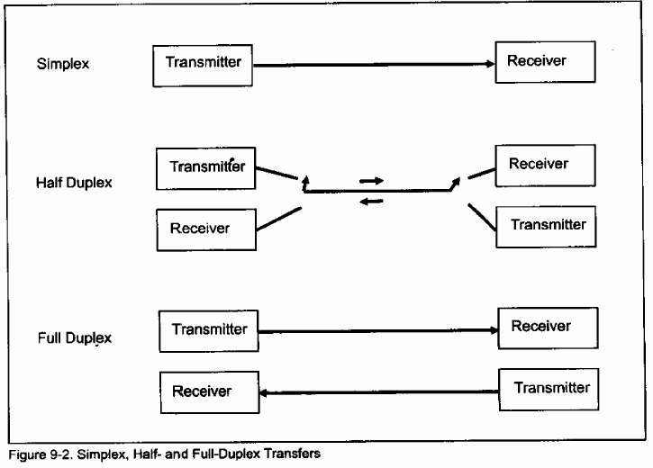
Transfer Types

Slide 6
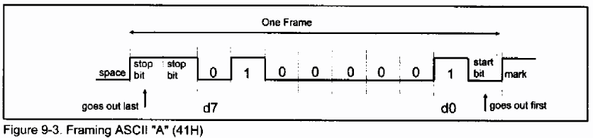
Asynchronous Data Framing
Idle (high): Mark
Low: Space
Overhead? (parity, start, stop)

Slide 7
Data Transfer Rate
Baud rate
bps

Slide 8
RS-232 Standard
EIA 232 = ITU-T V.24/V.28
Specifies the interface between DTE and DCE:
V.28 : mechanical and electrical characteristics
V.24 : functional and procedural characteristics
Even used in applications where there is no DCE
e.g. connecting computer to printer, magnetic card reader, robot, … etc.
Introduced in 1962 but is still widely used
Stand for Recommended Standard

Slide 9
Vocabulary
DTE
data terminal equipment
e.g. computer, terminal
DCE
data communication equipment
connects DTE to communication lines
e.g. modem

Slide 10
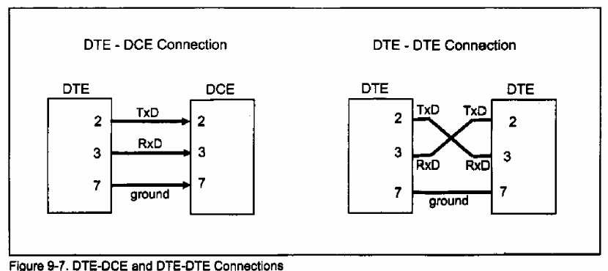
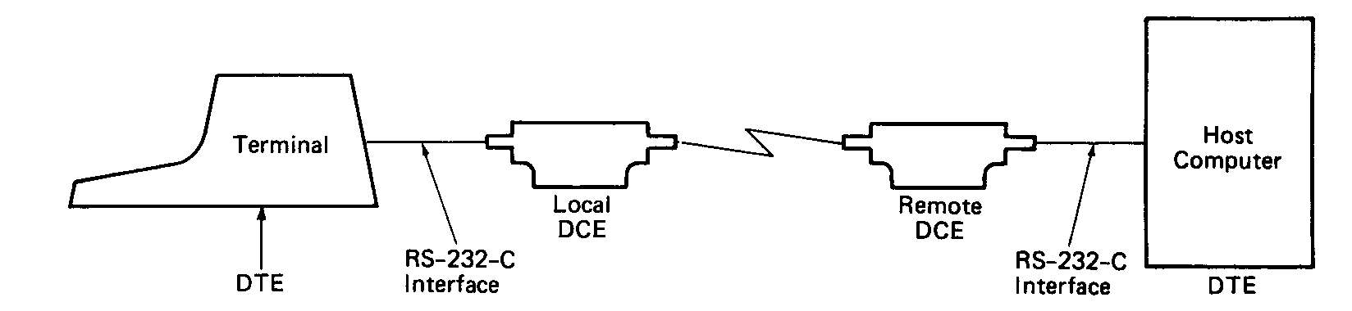
DTE Connections

Slide 11
RS-232

Slide 12
Mechanical Characteristics
25-pin connector
9-pin connector is more commonly found in IBM-PC but it covers signals for asynchronous serial communication only
Use male connector on DTE and female connector on DCE
Note: all signal names are viewed from DTE

Slide 13
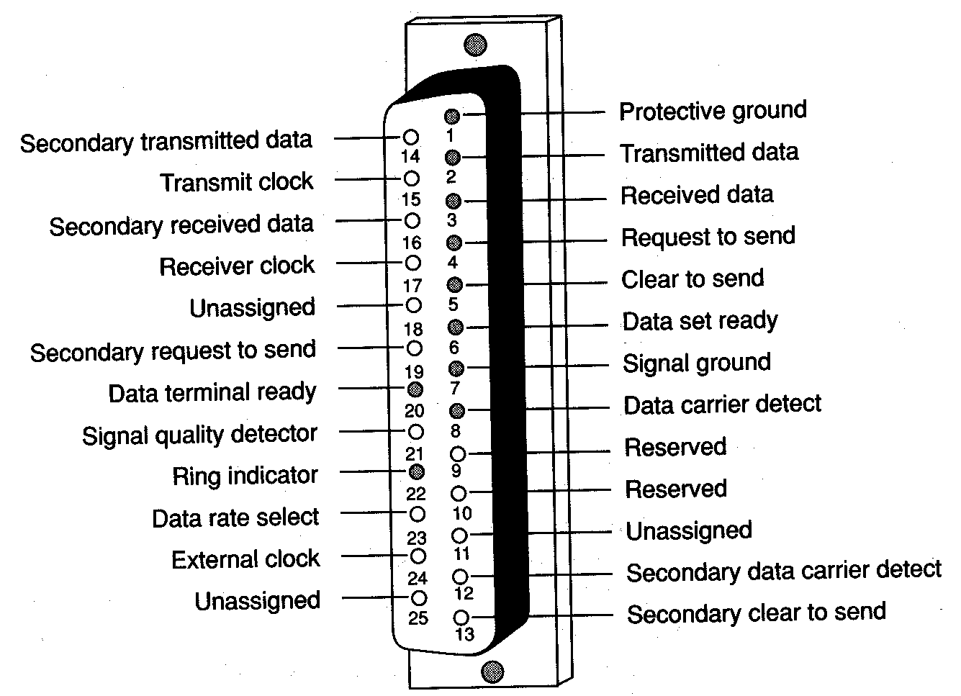
25-Pin RS232 Connector
Source: Duck, Bishop & Read, Data Communications for Engineers, Addison-Wesley

Slide 14
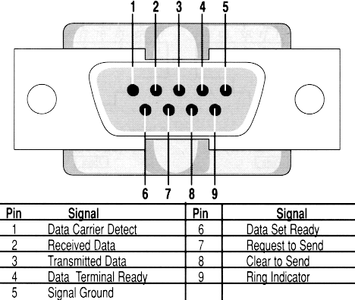
9-Pin RS232 Connector

Slide 15
Electrical Characteristics
Single-ended
one wire per signal, voltage levels are with respect to system common (i.e. signal ground)
Mark: –3V to –15V
represent Logic 1, Idle State (OFF)
Space: +3 to +15V
represent Logic 0, Active State (ON)
Usually swing between –12V to +12V
Recommended maximum cable length is 15m, at 20kbps

Slide 16
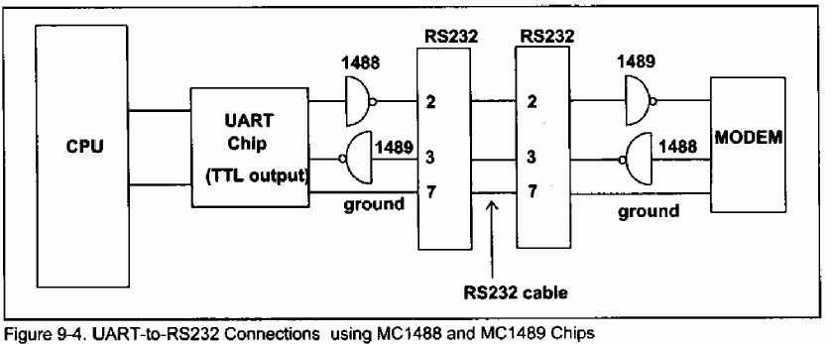
TTL to RS-232
Line drivers and line receivers

Slide 17
RS-232 Frame Format
Example
 |  |  | …
Start bit
ASCII
Parity
Stop bit
111101000001111
A
Idle

Slide 18
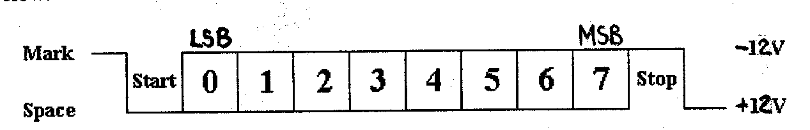
RS232 Logic Waveform

Slide 19
Function of Signals
TD: transmitted data
RD: received data
DSR: data set ready
indicate whether DCE is powered on
DTR: data terminal ready
indicate whether DTR is powered on
turning off DTR causes modem to hang up the line
RI: ring indicator
ON when modem detects phone call

Slide 20
Function of Signals
DCD: data carrier detect
ON when two modems have negotiated successfully and the carrier signal is established on the phone line
RTS: request to send
ON when DTE wants to send data
Normally constantly ON in point-to-point lines
CTS: clear to send
ON when DCE is ready to receive data
SG: signal ground
Notes:
RTS Used to turn on and off modem’s carrier signal in multi-point (i.e. multi-drop) lines

Slide 21
Flow Control
Means to ask the transmitter to stop/resume sending in data
Required when:
DTE to DCE speed > DCE to DCE speed
(e.g. terminal speed = 115.2kbps and line speed = 33.6kbps, in order to benefit from modem’s data compression protocol)
without flow control, the buffer within modem will overflow – sooner or later
the receiving end takes time to process the data and thus cannot be always ready to receive

Slide 22
Hardware Flow Control
RTS/CTS
the transmitting end activates RTS to inform the receiving end that it has data to send
if the receiving end is ready to receive, it activates CTS
normally used between computer and modem
computer is always ready to receive data but modem is not, because terminal speed > link speed

Slide 23
Software Flow Control
Xon/Xoff
when the buffer within the receiving end is nearly full, Xoff is sent to the transmitting end to ask it to stop
when data have been processed by the receiving end and the buffer has space again, Xon is sent to the transmitting end to notify it to resume
advantage: only three wires are required (TD, RD and GND)
disadvantage: confusion arises when the transmitted data (e.g. a graphics file) contains a byte equal to 13H (Xoff)

Slide 24
RS-232 (con)
Communication between two nodes
Software Handshaking
Hardware Handshaking
data transmission
Are you ready to receive?
RTS
CTS
RTS
x-off
CTS
No
receiver
transmitter
receiver
transmitter
x-on
RTS
CTS
Yes
TD
data transmission
Send character
RD
Notes:
Software flow control uses special characters to control the flow of data when a device wishes to halt the flow it sends the XOFF character, when flow can resume it sends the XON character. The XOFF character is called DC3 or Device Code 3. It is decimal 19 or control S. The XON character is called DC1 or Device Code 1. It is decimal 17 or control Q.
XOn / XOff is a software flow control mechanism. It can only be used in character oriented data transmissions (not binary transfer) as it relies on the use of a pre-determined XOn character and a pre-determined XOff character. The basic idea is simple, when the receiver buffer fills to the point it cannot receive anymore data it issues an XOff (Transmit Off) to the transmitter. When the transmitter sees the XOff character is stops transmitting. It will only resume once it sees a corresponding XOn. The disadvantage of such a system is that should an issued character become damaged in transit no action will be taken by the transmitter.

Slide 25
Null Modem Cables
Used to directly connect two DTEs together
Many possibilities – depending on whether and how the two DTEs handshake (i.e. doing flow control)

Slide 26
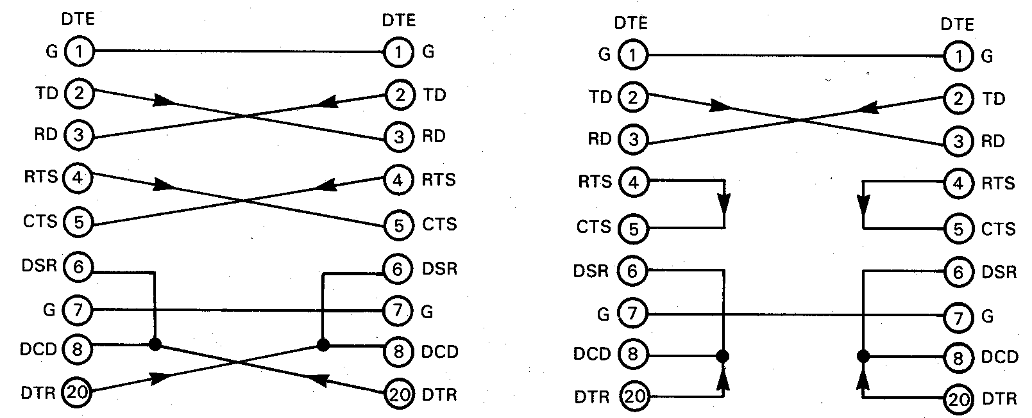
Null Modem Cables Examples
Source: Horowitz and Hill, The Art of Electronics, Cambridge University Press

Slide 27
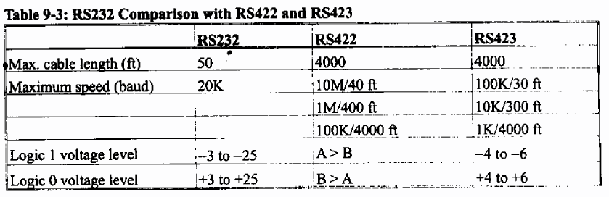
Other Standards

